Slide 1

TM
Lehigh Valley LaunchBox Presentation
November 29, 2017
Proprietary and Confidential

Slide 2
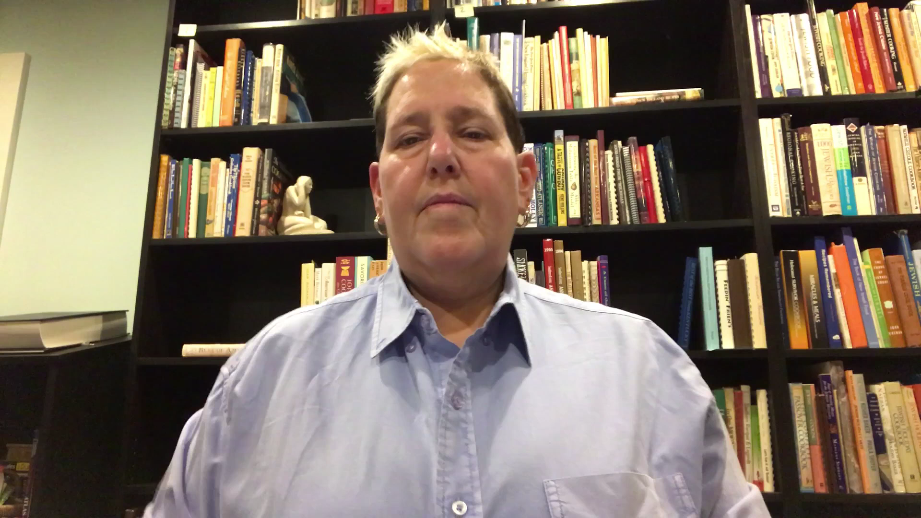
A Message From Our Founder
Sue Wolper, Founder and Executive Director of Recipe for Unity
YouTube Link

Slide 3
Presenting Today
Paul Gundlach - former Young & Rubicam advertising executive, Recipe for Unity board member
Matt Alexander - Co-editor and Art Director for Recipe for Unity

Slide 4
The Problem
America is divided and siloed
Political climate has emboldened hatred and divisiveness
Silos breed “tribes”/factions, which hinders understanding and open dialogue
Judgment: labels of “us” and “them”
Notes:
People are not talking with one another about connections, solutions, understanding. We have become an America of “others”--races, genders, ethnicities, ages, colors, religions, sexual orientations and all Americans
Racism, intolerance and hatred in America, where, as George W Bush noted recently, "bigotry seems emboldened" in the current political climate
What does it mean to be American?
The original focus was on immigration and immigrants, but we realized that this applied to anyone that struggles with “otherness”

Slide 5
The Solution
Bring people together around food!
Food = something we all share
Food = comes with stories that help identify each of us
Food = something that has a unique ability to bring people together
Notes:
Food serves as a way to comfort us, to bring us physically together, and to teach us about one another and about the contributions of centuries of contributions by the people who make up this country

Slide 6


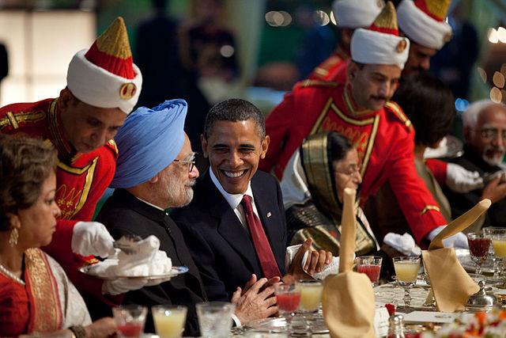
Proofs of Concept
Derek Black
2013, York
Culinary diplomacy, 1988
Notes:
Derek Black, son of a prominent white nationalist, diverged from the views of his father after being invited to Shabbat dinners, where he learned that those whose presence in the country he decried--those of different races, ethnicities, and religions--were people, just like him; through Shabbat dinner, these people found common humanity and inspired empathy
In 2013, the English Defence League was protesting a Mosque; the members of that mosque invited the protesters in for tea, biscuits and football, and through discussion that inspired, everyone found common ground and came to the conclusion that everyone present believed violent extremism is wrong
Culinary Diplomacy, an effort by the U.S. government that maintains that “the easiest way to win hearts and minds is through the stomach,” was launched in 1988 and has thus far been spread to official programs in Thailand, South Korea, Malaysia, and Peru. Culinary Diplomacy efforts can range from increasing the number of Thai restaurants worldwide to the United States sending members of the “American Chef Corps” abroad for diplomatic missions.

Slide 7
Recipe for Unity™ - Business Concept
Mission: “To foster and facilitate conversations about diversity, equity, and inclusion using food as a catalyst to bring people together”
Unique, fact- and data-based approach to encourage unity
Web-based, building a site to serve as both a community hub and a resource center
Help create environments that make people comfortable with conversation
Notes:
Mention RFU by name, registered 501(3)(c) with a mission to “foster and facilitate conversations about diversity, equity, inclusion using food as a catalyst to bring people together”
Create a website acts as a hub and resource to bring people together to respect differences and honor similarities--a “social justice site masquerading as a food site”

Slide 8
Recipe for Unity™ - Approach
Achieve scale by using a “teach the teachers” model
Promote via search, social media, and community involvement
Target audience(s):
Teachers
Faith-based leaders
Corporate HR/diversity officers
Social justice - academics and activists
Parents and caregivers
“Curious foodies”
Notes:
Teaching the teacher--faith-based leaders, civic leaders, teachers, parents, and HR types alike can usd our tools to learn how to bring their constituents together
As our approach is unique, it is difficult to identify and classify direct competition

Slide 9
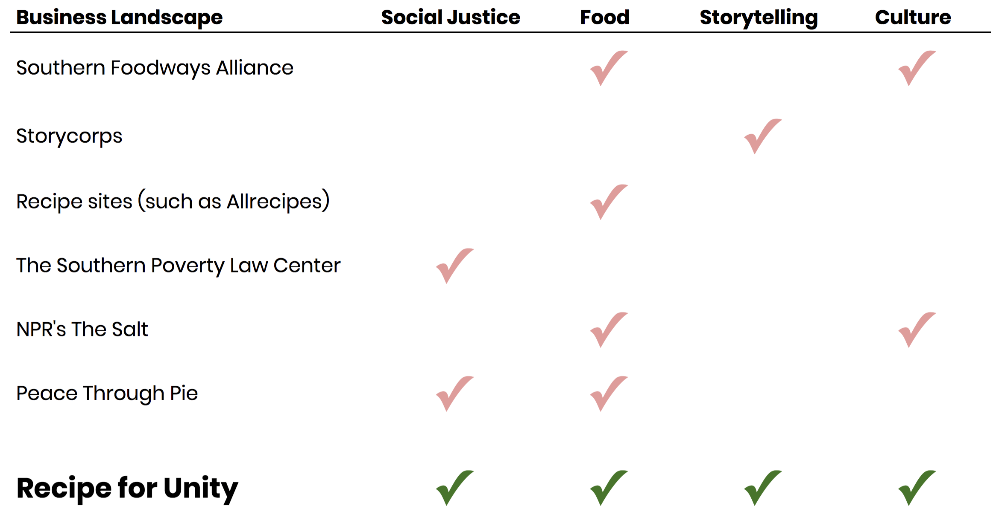
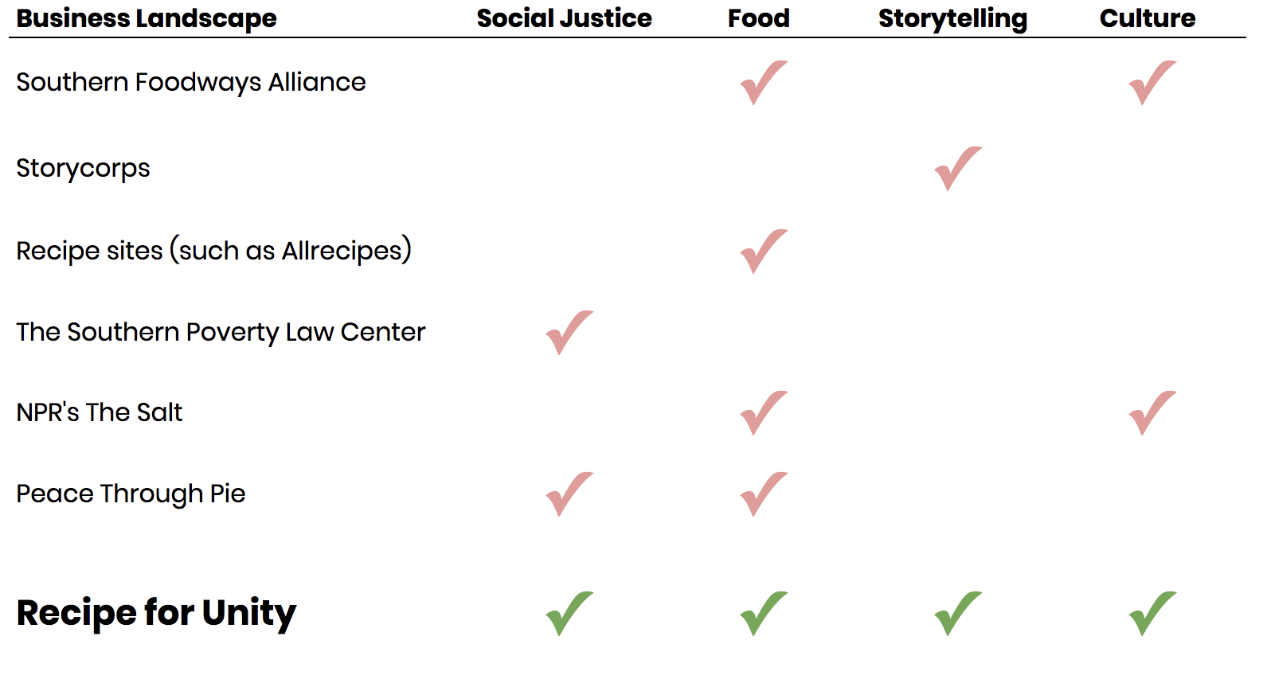

Slide 10
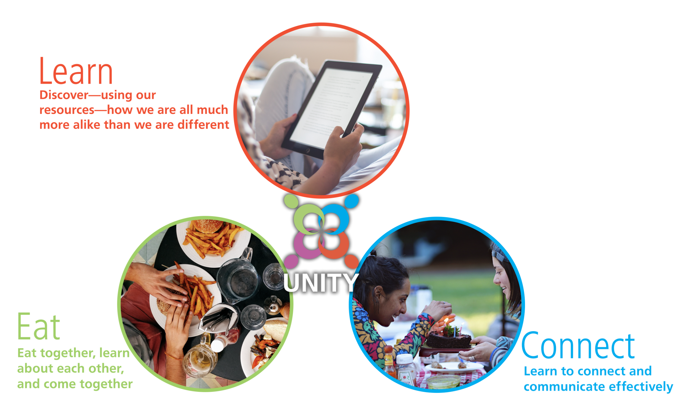
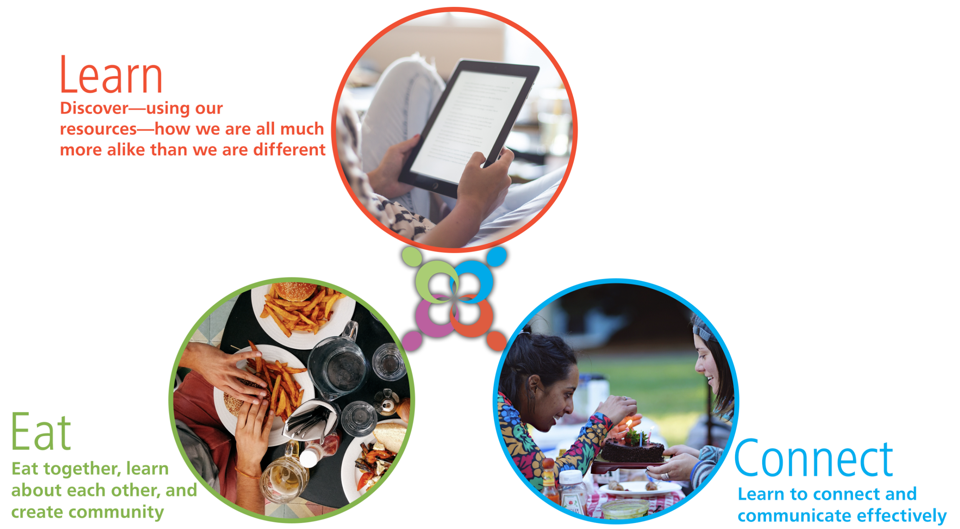

Slide 11
Learn
Resource center, providing both original and curated educational content
Fact Sheets - downloadable pages with facts on different groups and topics
White Papers - related to food, diversity, equity, and inclusion
Blog - featuring articles written by Recipe for Unity and guests
Maps, journal articles, related links
Notes:
Learn is not just about discovering similarities through food; it is much, much more. Fact sheets are about culture, celebrations, etc. Fact sheets may also be about myths about LGBT, there will be census data, so the Learn section is about curating original and current content to allow people to learn about topics they want to discuss and learn about.

Slide 12
Eat
Creating community, providing information about the strength and importance of eating together
Recipes - offering and collecting recipes to build a nationwide cookbook
Food Stories - soliciting and contributing stories to illustrate our experiences with food and our common humanity
Zip Code Map - a place to see where our virtual community lives across the country
Notes:
Eat is not just about eating together, it’s about using food as a tool to bring people together, to teach people, to make people comfortable.

Slide 13
Connect
Providing tools to help people create effective conversations that lead to greater empathy, understanding, and unity
Resources, tips and tools for connecting - how to connect and communicate with different demographics
Each Day, Any Day - little things you can do every day to connect to people through food
Notes:
Connect is not just about getting tips for hosting a food gathering; it’s also about how to connect, how to choose a topic, etc

Slide 14
Where Are We Now?
Scheduled to launch website in February 2018
Site currently under development by The Kyle David Group
Generating content:
Collecting and curating content
Fact Sheets
Blog articles
Website copy
Recipes and Food Stories

Slide 15
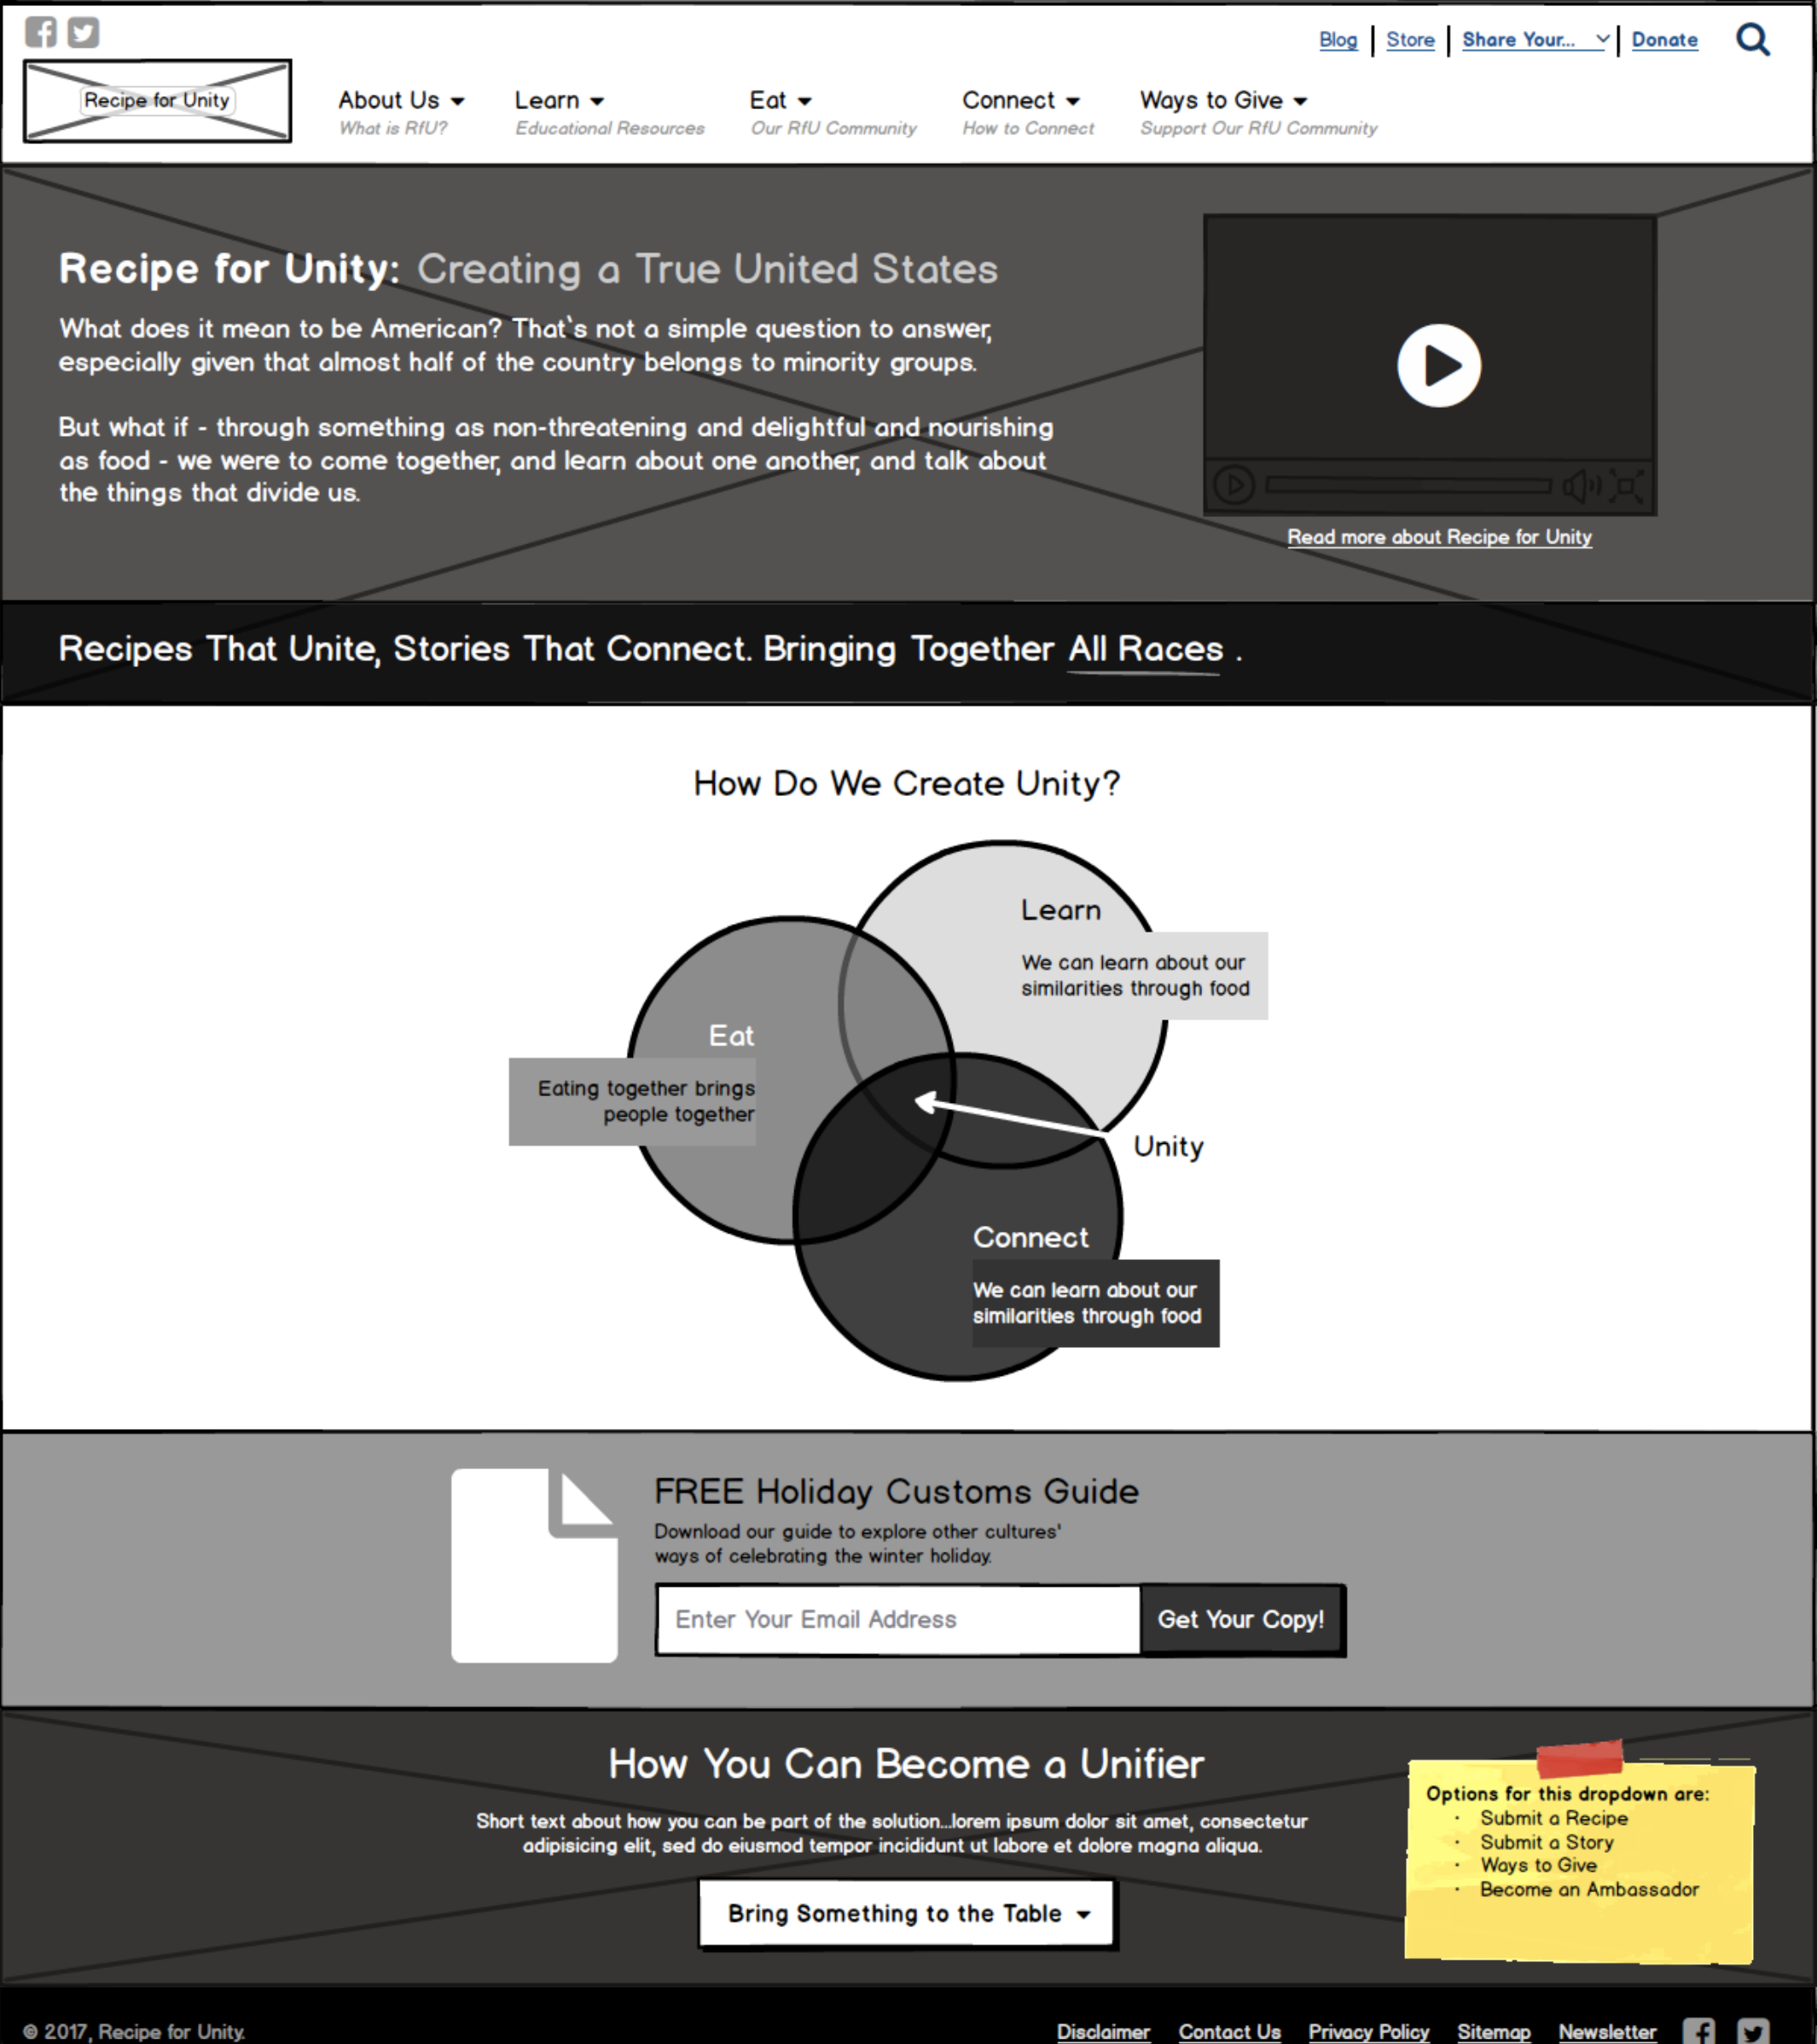
Example of wireframe homepage from website under development

Slide 16
The LaunchBox Community
Recipe for Unity will...
...contribute to the Lehigh Valley community at large
...work with other LaunchBox participants
...credit LaunchBox as an important contributor to the success of our program
Notes:
Rfu recognizes that we’re part of the Lehigh Valley community (and potentially the LaunchBox community) and that we have an interest and responsibility to share our experience and knowledge
Building relationships with community leaders to share our vision and our mission and to gather feedback (which we’ll continue to do on a continuous basis through our relationships and on our website?
Will contribute to the community, work with other LaunchBox participants, will give credit to the LaunchBox program for helping us become successful
Put LV launchbox on sponsorship page
Issue press release

Slide 17
Summary/Conclusion
“If you really want to make a friend, go to someone's house and eat with him... the people who give you their food give you their heart.”
~ Cesar Chavez

Slide 18
Thank You!
Questions and Answers

